Slide 1
Electric Motor Temperature
Group 6 :
Presented by
1. Kaadhuluri Kiran Kumar Goud
2. Kunal Kanhaiyala Sharnagat
3. Apoorv Gupta
4.Pratiksha Nagraj Patil
5. Aditya Vamsi Reddy Kandula
6. Sagar C Choudhari

Slide 2
Business Problem
Predict Motor Speed (“motor_speed”) based on other attributes available are like ambient, coolant, torque, current d_q components, voltage d_q components, stator yoke, stator tooth, stator winding, permanent magnet and profile_id.

Slide 3
Project Architecture / Project Workflow
Data cleansing
Duplicate values removal
Missing values treatment
EDA
Outlier treatment
Feature Engineering
Data pre processing
Data type conversion
Normalising/ standardising the data
Data visualisation
Model building
Model evaluation
Evaluating using RMSE metric
Model deployment
Deploying using Streamlit
Regression model

Slide 4
Data Cleansing
There are 998070 rows and 13 columns in the training dataset
there are no NA and duplicate values in the given data set.
Check all the business moments.
Majority of the variables are right skewed and has long tail in the end.
While others are left skewed and has long tail in the beginning.
We will remove the 1st variable because it’s a serial number.
When we check the structure of the data set except profile_id others are numeric. Now we have to convert profile_id into factor.
Exploratory Data Analysis : (EDA)
After converting into factor we will get 52 levels.
Now find the correlation ship between the variables. There is a collinearity also.
Now we have to make the profile_id into unique, by doing this we will come to know how many levels are there.
The data set will follow normality.
When we used scatterplot we came to know about linearity. Data set follows positive linearity.
Histogram and bar plot will help us to find the variation in the data set.

Slide 5
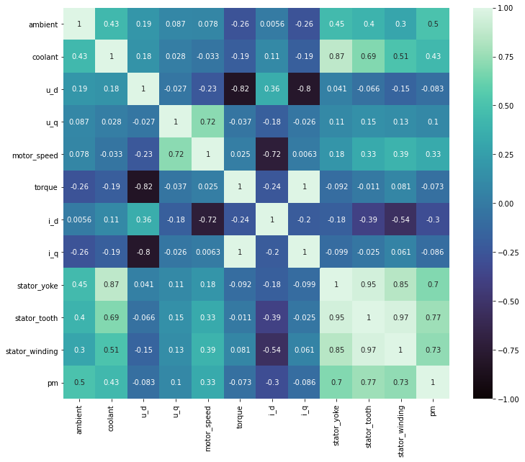

Heat plot will tell us whether there are any NA values and correlation of the variables.

Slide 6
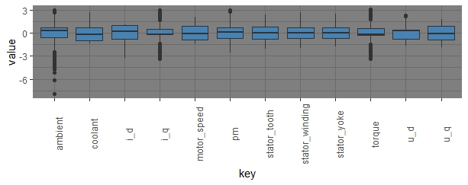
Outliers: Ambient i_q Torque Outliers are removed Using caping technique of outlier treatment.

Slide 7
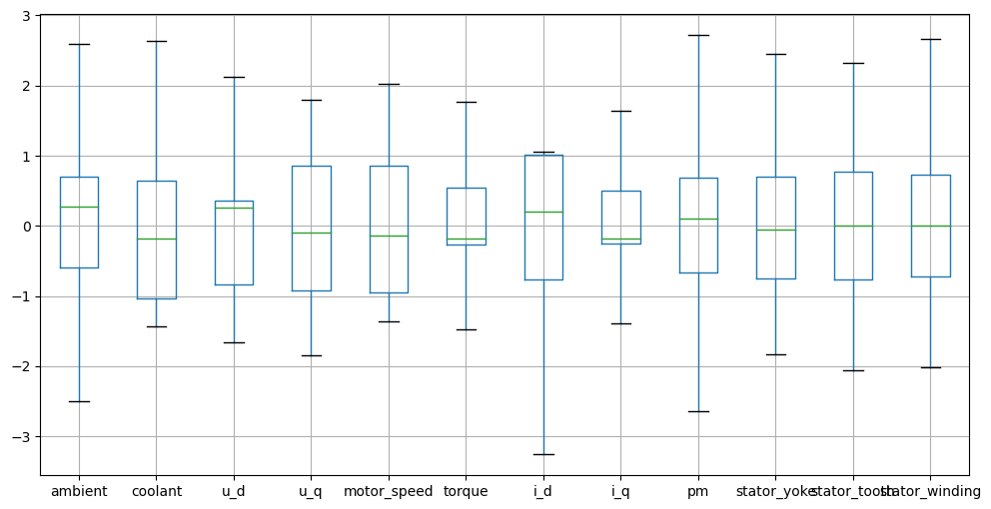

Slide 8
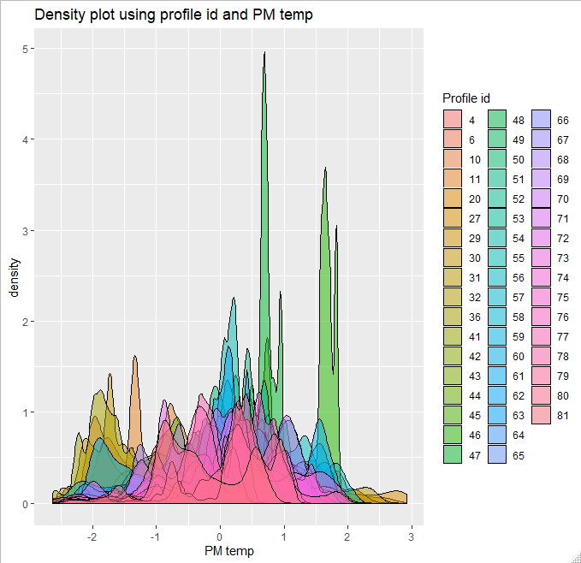

Slide 9
Model Building :
Data Set Details :
998070 rows and 13 columns
Data - Continuous
Data Partition :
Data is divided into 70:30 train and test.
Based on this data we are going to perform Model Building.
Train = 698649 rows X 11 Columns
Test = 299421 rows X 11 Columns
Linear Regression
XGBoost Regressor
K-Nearest Neighbour Regressor
Adaboost Regressor
Random Forest Regressor
Decision Tree Regressor
ALGORITHMS :

Slide 10
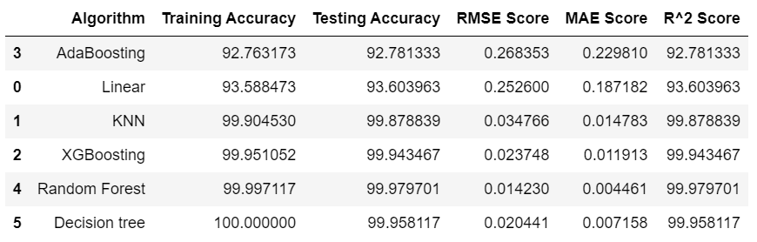
Model Evaluation :

Slide 11
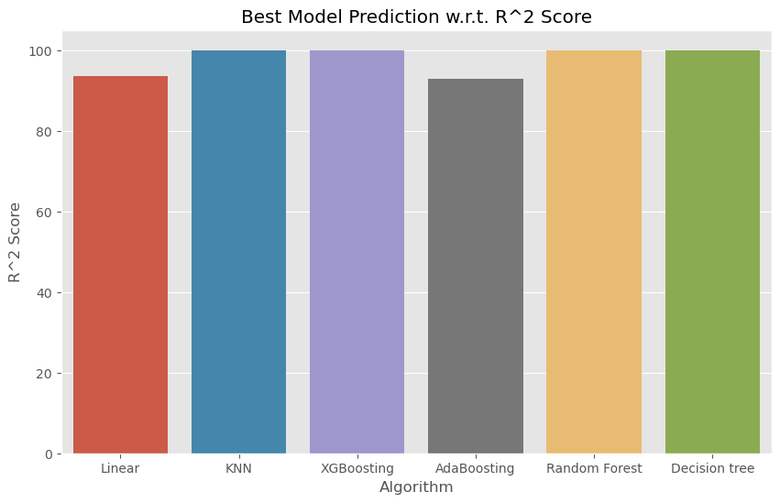

Slide 12
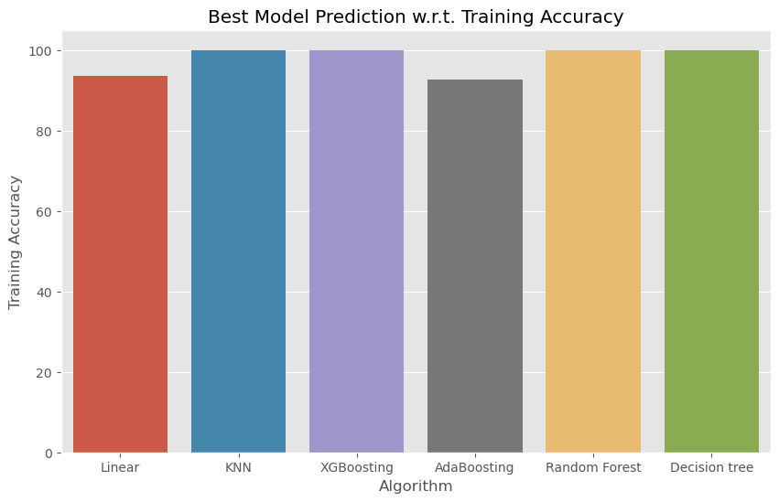
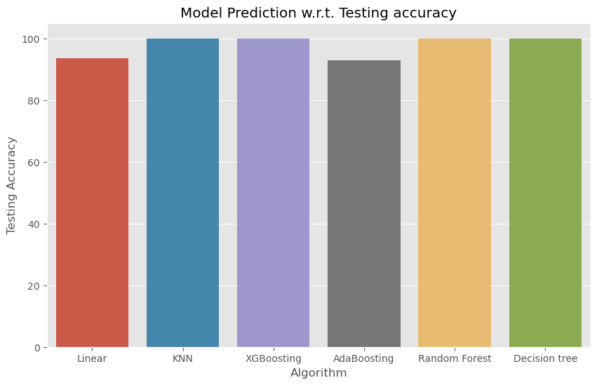

Slide 13
Model Deployment using STREAMLIT
Step 1 :
from pickle import dump
from pickle import load
#save the model to disk
filename = 'finalized_model.sav'
dump(x_reg, open('filename', 'wb'))

Slide 14
Step 2 :
Create a Deployment code using .py format
Though Random Forest gave good predictions, due to large data, we couldn’t use that model for deployment. Therefore, we used XG Boosting Regressor for Deployment.
Add the same file in GitHub repository.
Download Streamlit.
Connect the github repository to the Streamlit and run the code.
The output for every prediction will be in an separate Excel file.

Slide 15
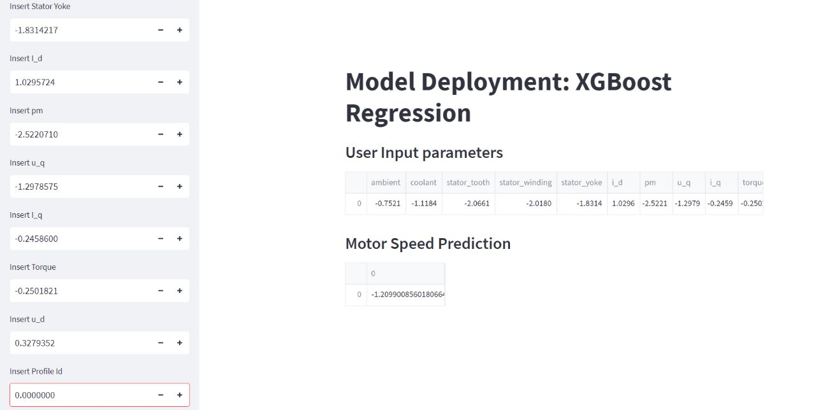

Slide 16
Challenges Faced:
Data visualisation took more time for plotting data.
The dataset contained with large amount of outliers.
Feature selection doesn’t improve the model evaluation metrics.
Model building was more complicated since, size of data set is very large.
Model deployment was complicated
How did we Overcome :
Data visualisation was done for unique profile_id instead of whole dataset.
Outliers are treated using caping technique of outlier treatment.
From Feature selection profile_id also part of training dataset.
Model deployment was done using Streamlit.

Slide 17
Thank You

